Slide 1
Joint Angles Visuallization in Running Exercise

Slide 2
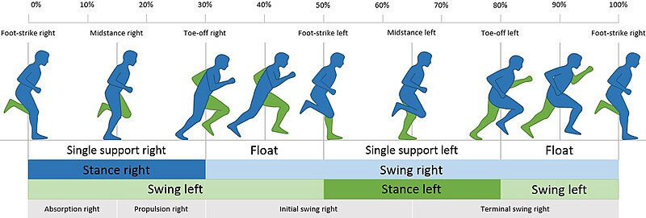
1. Introduction
1.1. Phases of Sprinting
Stance phase
Initial swing
Mid swing
Terminal swing
Which Muscle Groups Are Used in Running?
How the Hip Moves while Running

Slide 3
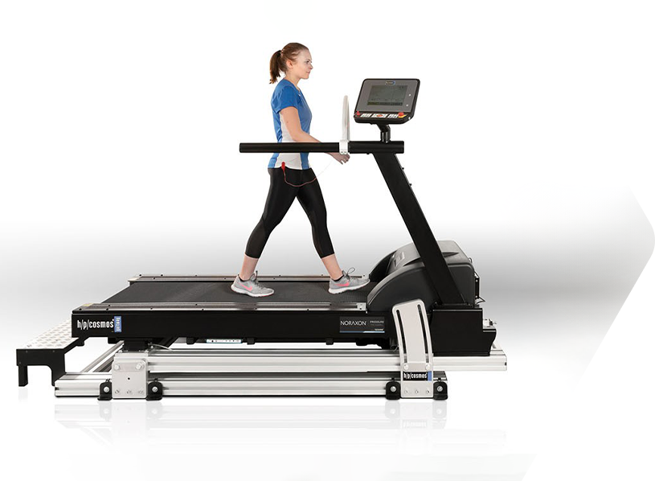
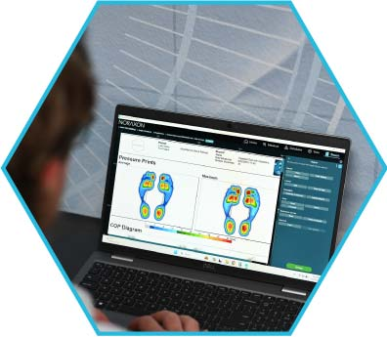
1. Introduction
1.2. Recording System
1.2.1. Pressure-Instrumented Treadmills - myoPRESSURE™
Individually-calibrated capacitive sensors measure data to conduct static and dynamic plantar pressure mapping.

Slide 4
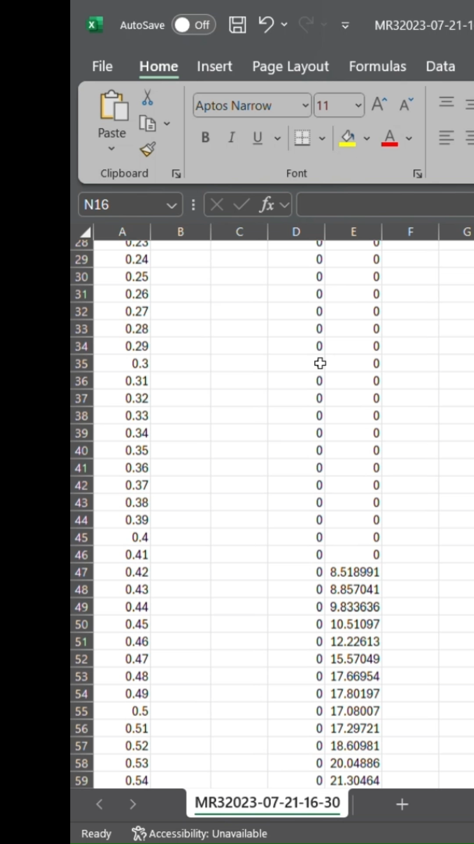
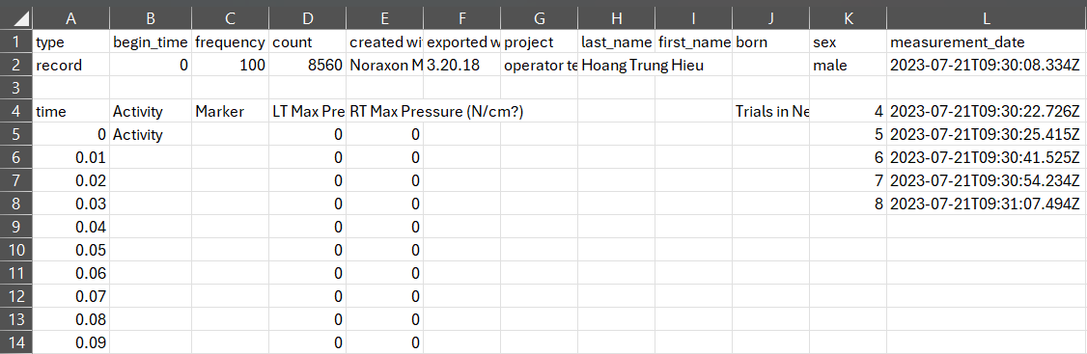
1. Introduction
1.2. Recording System
1.2.1. Pressure-Instrumented Treadmills - myoPRESSURE™
Frame
Left and Right Max pressure on each foot
Start time of each cutted file
Start time of this file
The two legs should alternate with each other like this

Slide 5
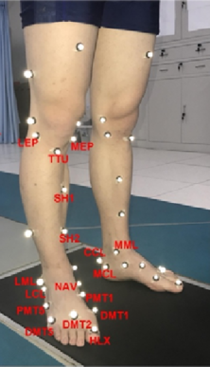
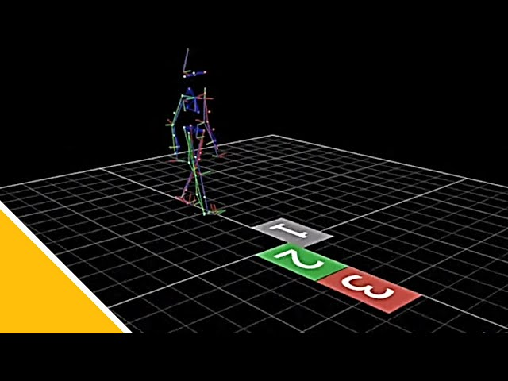
1. Introduction
1.2. Recording System
1.2.2. Motion Capture for Biomechanics - Nexus
3D coordinates of markers

Slide 6
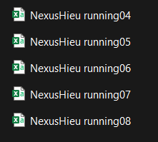
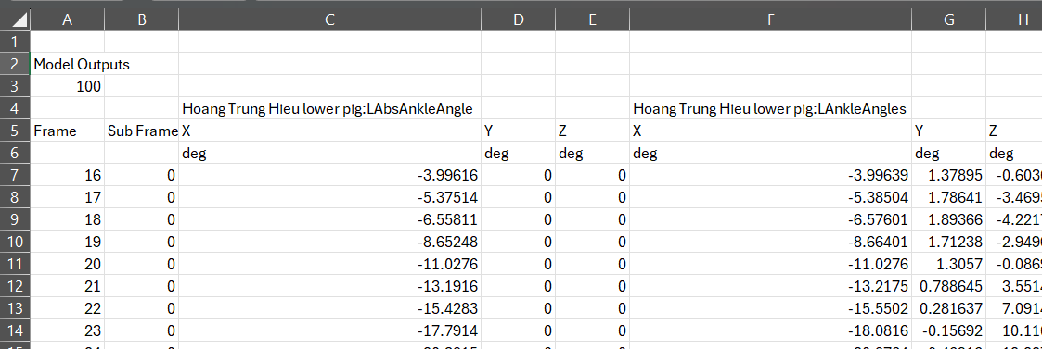
1.2.2. Motion Capture for Biomechanics - Nexus
Angle name
( L: Left + Angle angle)
Angle in ....
Frame

Slide 7
1. Introduction
t0
1.2. Recording System
t1
MR Output file
t2
t3
Nexus Output file
t4
2 file is recorded in the same
time and resolution (frame)
t5
The Nexus file is cutted into several segments and still keep the start time when cutted
MR file
Nexus files
Simulation of file segments of Nexus
corresponding to MR file in Frame field
t1, t2, ... : start frame of n-th segment
of Nexus file

Slide 8
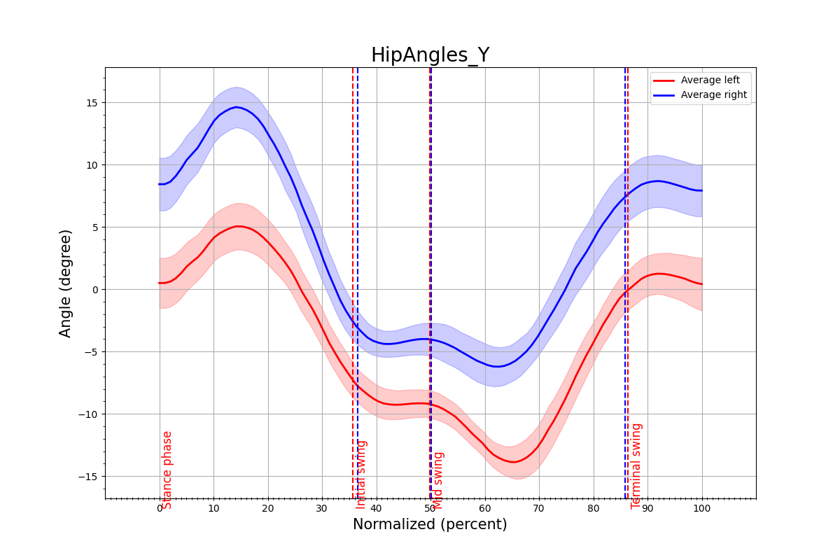
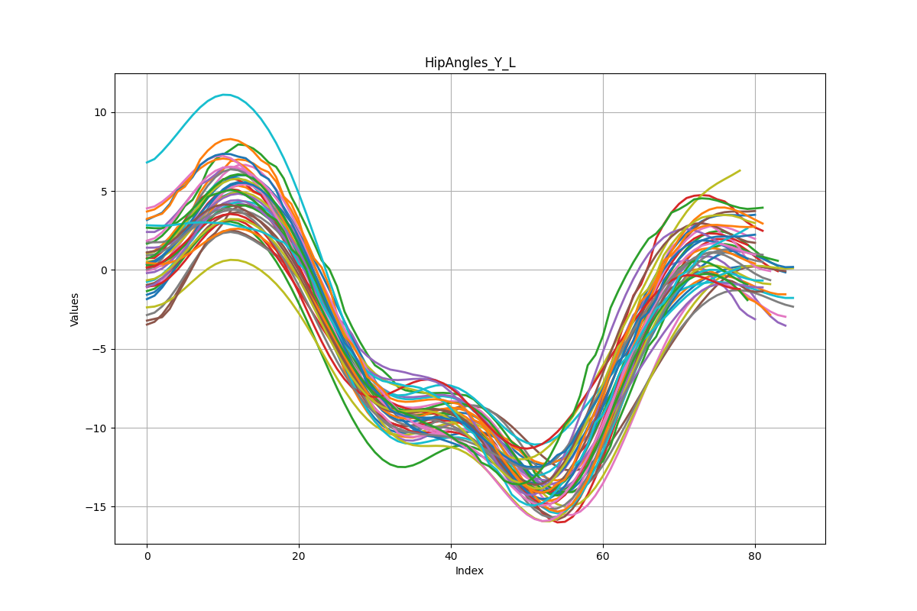
2. Workflow
n-th cycle
(2)
(3)
 | T1 | T2 | T3 | T4 | .....
1 | X1
2 | X2
3 | X3
..... | .....
(4)
m-th frame on each cycle
Start-end frame of each cycle
(1)
Average phase
(5)
(6)

Slide 9
2.1. Process (1): Processing the MR file and receive the information of each phase in cycles
1
2
Frame index
5
6
7
8
9
10
11
12
0 values
First, we need to assign the process to the stick bar for easier visualization.
The file is distributed longitudinally, so the longitudinal stick bar represents the
pressure values that differ from 0 in two columns: Left foot pressure and Right
foot pressure.
The gap between each bar in the longitudinal direction represents values of 0.
The frame increases from the top to the bottom of the chart.
The main task of these bars is to identify the time when the pressure changes
from 0 to a non-zero value. This is the moment when the phase changes.
1 right
cycle
a
1 left
cycle
b
c
d
Pressure
sequence
1
Left pressure column
Simulation of left & right pressure column
a: Stance ; b: Initial Swing
c: Mid Swing ; d: Terminal Swing
2
Right pressure column

Slide 10
Function 1: Find value come back from pressure to zero : find_zero_seg
Start
Input :
pressure : array of column of pressure
frame_start: first frame of pressure sequence
Output:
The last frame of pressure sequence
Initialize i = frame_start
Frame index
5
6
7
8
9
10
11
12
While pressure[i] > 3
frame_end_pressure
i+=10
pressure[i] >3 or not
This funcion aims to find what frame that the pressure sequence come back to zero sequence. This point can be end of stance phase or end of mid swing phase
while pressure[i]<=3
i - =1
Action
pressure[i] < 3 or not
Dicision
return i+1
Do If Yes
End
Do if No

Slide 11
Function 2: Find value come back from zero to pressure: find_pres_seg
Input :
pressure : array of column of pressure
frame_end_pressure: last frame of pressure sequence
Output:
The last frame of zero sequence
Frame index
5
6
7
8
9
10
11
12
frame_end_pressure
The structure is inverted
with Function 1
This funcion aims to find what frame that the zero sequence come back to pressure sequence. This point can be end of stance phase or end of mid swing phase

Slide 12
Function 3: Receive the phase information from MR file
Start
check_start_left_or_right = -1
while left_pressure[now_frame] == 0 and right_ pressure[now_frame] ==0
This function aims to determine which foot starts first.
If the Left foot starts first, it means the value in the left pressure column differs from 0 first. The flag check_start_left_or_right is set to 0, and then Block A is executed.
Block A loops through each row in the Excel file, returning a list containing the stance, initial swing, mid swing, and terminal swing phases of each foot, and saves the results to another Excel file.
Otherwise, if the Right foot starts first, check_start_left_or_right is set to 1, and Block B is executed.
The difference between Block A and Block B is that Block A is designed for cases where the Left foot starts first, while Block B is designed for cases where the Right foot starts first.
now_frame += 1
left_pres[now_frame] != 0
check_start_left_or_right = 0
Block A
right_pres[now_frame] != 0
check_start_left_or_right = 1
Block B
End

Slide 13
Block A
Start
1
2
stance _left = now_frame
Frame index
Stance_left
5
6
7
8
9
10
11
12
initial_swing _left = find_zero_seg(
stance _left, left_pres)
initial_swing_left
mid_swing_left
mid_swing _left = find_pres_seg(
initial_swing _left, right_pres)
stance_right = mid_swing _left
stance_right = mid_swing _left
terminal_swing _left = find_zero_seg(
mid_swing _left, right_pres)
initial_swing_right = terminal_swing_left
terminal_swing_left
now_frame = mid_swing _right
mid_swing _right = find_pres_seg(
initial_swing _right, left_pres)
Every variables is stored to lists
1
Left pressure column
End
2
Right pressure column

Slide 14
2.2. Process (2) and (3): Find index of angle on Nexus file with corresponding frame on MR file
Define the initial construct
First, we need define the corressponding angle on each frame on Nexus file with the corresponding pressure on each frame on MR file. Because MR file contrain information about the cycles
Let imagine that initial we have the whole MR file, so we represent the frame column of MR file by a long green stick
Nexus produce several files, we represent it by several shot stick, with blue stick is frame column of Nexus file, yellow stick is corressponding angle at that frame
At the first time , there are a gap on 2 kind of file because we can not locate what frame of Nexus corresponding with what frame of MR

Slide 15
2.2. Process (2) and (3): Find index of angle on Nexus file with corresponding frame on MR file
Process (2):
Let read the start time of the each recording.
Assume
t0 is start time of MR file on second
tn is start time of Nexus segment file on second
1 frame = 1/100 second
Then the first frame of Nexus file will be attached with the frame (tn – t0)*100 of MR file
Process (3):
Only keep the corressponding frame on MR with angle on Nexus
Can be considered as a DataFrame contains 2 column without NaN, 1st column is frame, 2nd column is angle
Can be considered as a DataFrame contains 3 column with NaN at the gap of 2nd and 3rd column

Slide 16
2.3. Process (4): Creating DataFrame contain angle on cycles
Start
Frame | Angle
... | ...
... | ...
... | ...
Iterate through each pair of start_frame, end_frame of processed file
Start frame
of cycle i-th
start_frame >= first frame
end_frame <= last frame
Initialize cycle_angles = [ ]
End frame
of cycle i-th
Iterate through each frame of DataFrame A
DataFrame A
frame >= start_frame
frame <= end_frame
cycle_angles.append(angle)
Action
cycle_frames start at start_frame and end at end_frame?
Dicision
angles_in_cycles.append(cycle_angles)
Do If Yes
Done
Do if No
End
Dicision
Dicision

Slide 17
n-th cycle
 | T1 | T2 | T3 | T4 | .....
1 | X1
2 | X2
3 | X3
..... | .....
m-th frame on each cycle
Angles
DataFrame B
angles_in_cycles then have the form as the dataframe above, with each column represent each cycle and each row represent each angle at each frame on that cycle. So It often contain the NaN value at several bottom row of some column because the length of each cycle are usually difference

Slide 18
2.4. Process (5) and (6): Plotting chart from the calculated information
Process (5):
Plot the plot with x-axis represent the frame in cycle, y-axis represent the angle value at that frame. Each line is drawn from each column in DataFrame B this plot help to see the fluctuation of angle of person on running.
However, DataFrame B orriginaly have the cycles with the difference length, we need to normalize the length to one fixed value to se the all the average representations of angles in a cycle. Then the length will be normalized from 0 to 100% and the fluctuation will be vizullized by standard deviation of these point
Process (6): with each x from 1 to 100 (interger), we will take the angle at x% of each cycle, to calculate mean and std at point x%
Assume:
Ti is the i-th cycle are considerring
Iterate through each value x in range(1,100)
Interate through each column in DataFrame B, determine the frame in cycle which is at x% of cycle length Ti, extract the angle at this frame, append to list containing the set of angle at x%
The result is expected that at each x% from 1 to 100 will be contain a set of angle value
Ti
Tj
Frame index
5
6
7
8
9
10
11
12
x% of Tj
x% of Ti
b
a
Here is an example of what happened in the process (6), with Ti ( have length a), Tj ( have length b) is two ramdon cycle, they have difference value of cycle length although bot lies on an DataFrame B, so the shoter cycle (Tj) will contain some NaN values. So x% of Tj and x% of Ti will have difference index on the frame column. This is why we need to re-calculate the frame index in the term of percent
NaN

Slide 19
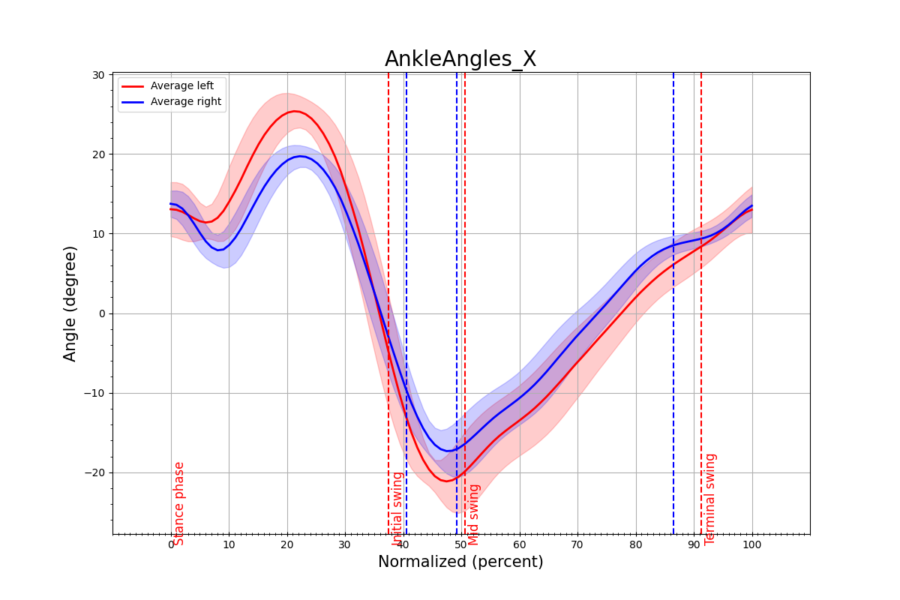
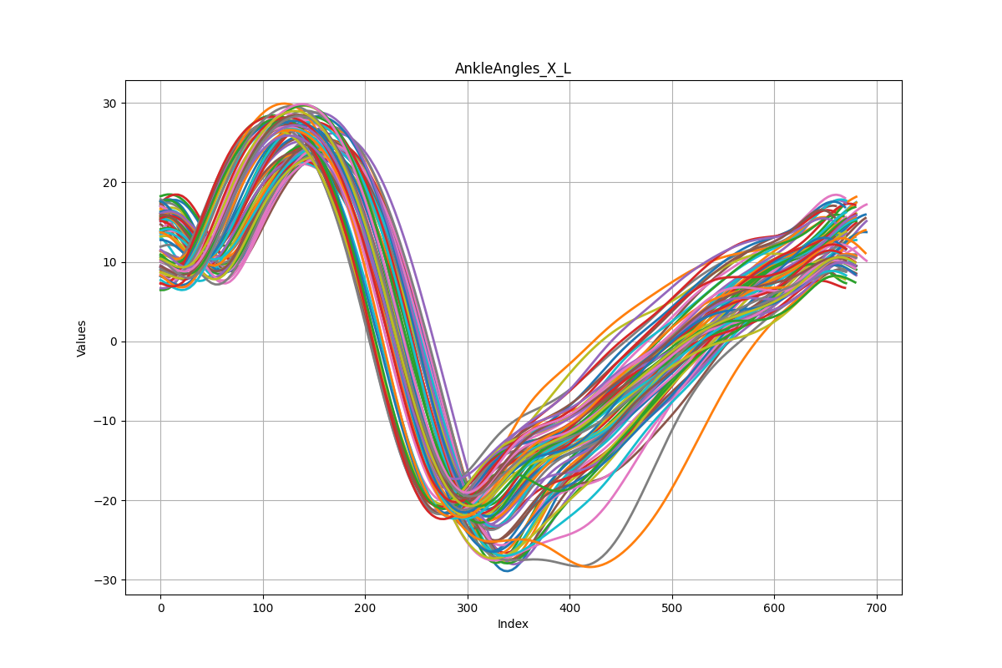
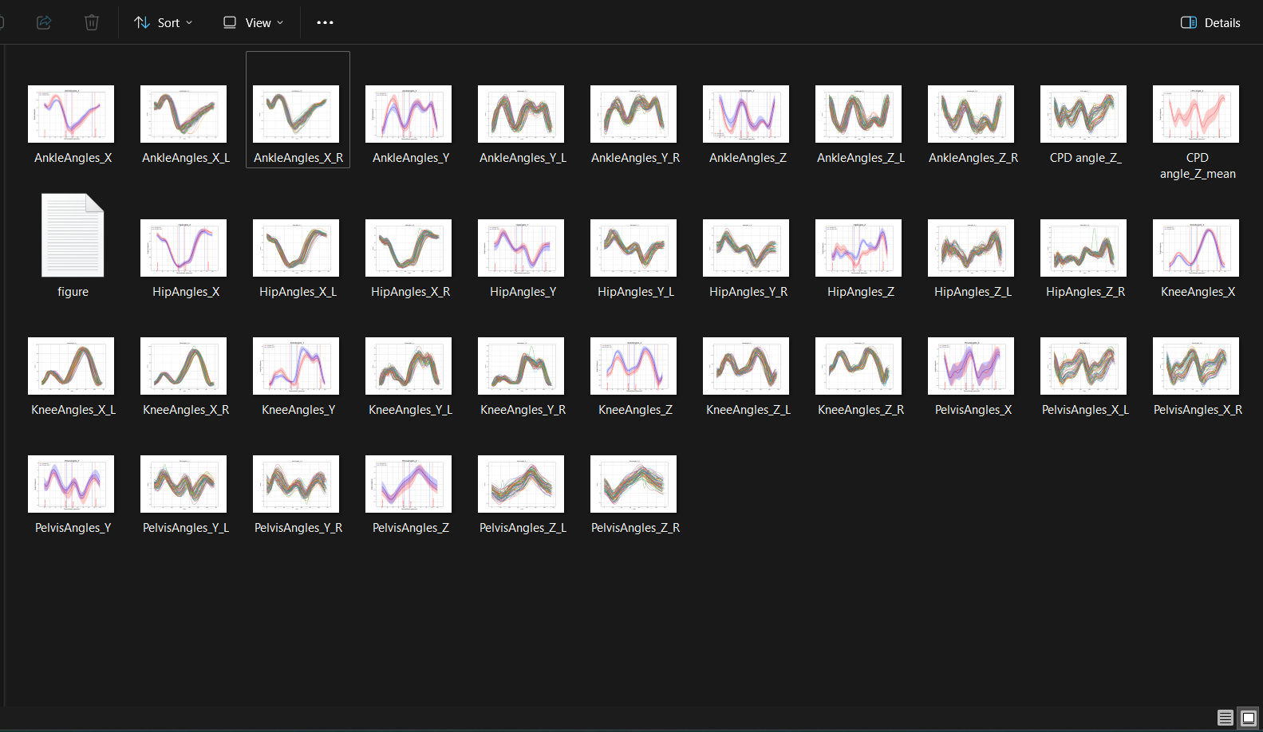
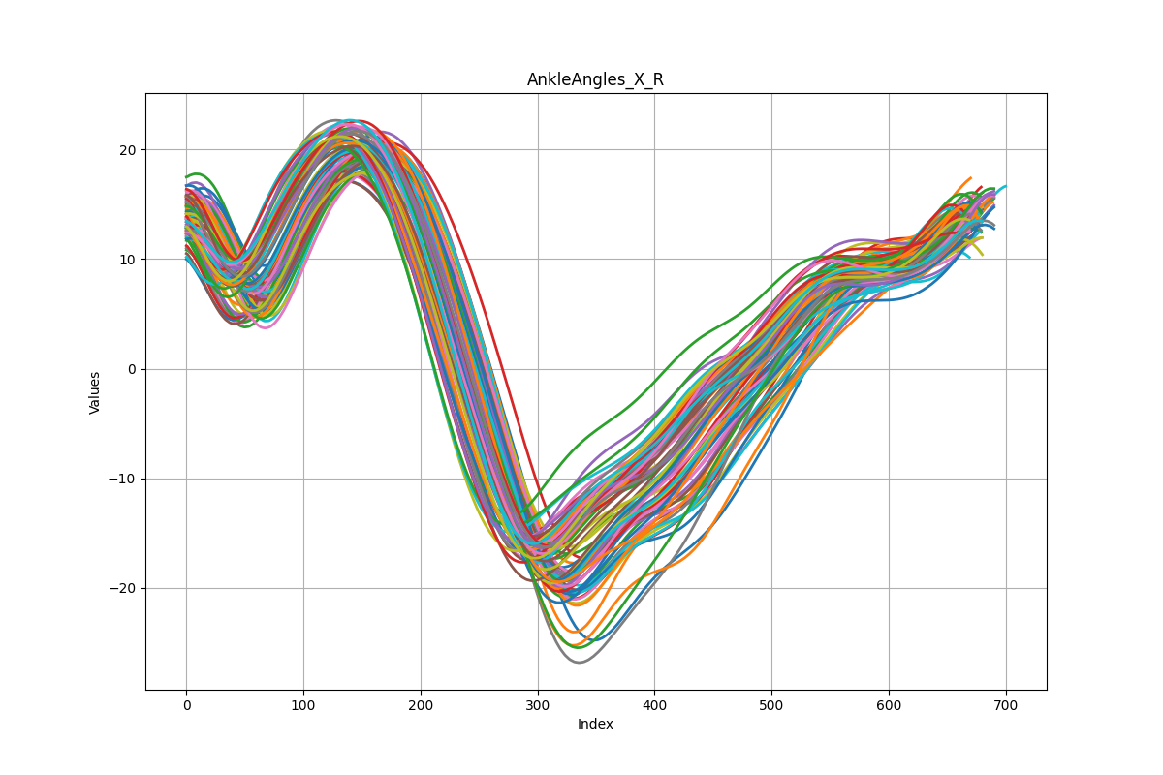
3. Results:

